Slide 1
2D Data Structures – how, why, when?
Part 1

Slide 2

Consider
Discuss how can you make a Python list 2-dimensional? (or 3 for that matter?)
What are some possible applications?
How would you code and parse a 2D data structure?
Notes:
Creating multidimensional lists (which can function as 2D, 3D, etc., data structures) in Python can be achieved through the concept of nested lists. A list is a versatile data structure in Python which can contain elements of different data types, including other lists.
Applications of Multidimensional Lists:
Representing data: In fields like data science and machine learning, multidimensional lists are often used to represent and manipulate data. For instance, a 2D list can represent a matrix or a data table.
Spatial problems: In game development or graphics programming, 2D and 3D lists can be used to represent grids or spatial coordinates.
Graphs and trees: In more advanced data structures, multidimensional lists can represent graphs or trees.

Slide 3
Accessing a 2D list (List of Lists)
two_dim_list = [[1, 2, 3], [4, 5, 6], [7, 8, 9]]
two_dim_list[1][2]
Warm-ups were worth it!
Notes:
Ensure students can understand which subscript corresponds to rows (first one) and which to columns and why.
Ensure students write list and are able to access elements by number
Show that python allows us to write it on multiple lines…

Slide 4

More readable presentation
two_dim_list = [[1, 2, 3],
[4, 5, 6],
[7, 8, 9]]
two_dim_list[1][2]
That’s better!
Notes:
Both lists are the same, but python allows us to use whitespaces without semantic meaning within brackets square, curly, or round and this can enhance readability.

Slide 5
Sequential iteration (nested loop pattern)
two_dim_list = [[1, 2, 3], [4, 5, 6], [7, 8, 9]]
for row in two_dim_list:
for elem in row:
print(elem, end=' ‘)
print() # Delete me to see what I do!
Notes:
demonstrates a common pattern in programming known as "nested looping", specifically with 2D data structures like lists of lists (which can be thought of as a matrix or a grid).
The for loops iterate over each row of the two_dim_list, and then for each row, they iterate over each element within that row. This pattern is often used to traverse 2D data structures where you need to access every element. The outer for loop goes through each sub-list (row), while the inner for loop goes through each element within the current sub-list.

Slide 6
Iteratively created a rows x cols list
rows, cols = 3, 3 # define the size of your 2D list
two_dim_list = []
for i in range(rows):
row = []
for j in range(cols):
row.append((i+1)*(j+1))
two_dim_list.append(row)
print(two_dim_list) # prints: [[1, 2, 3], [2, 4, 6], [3, 6, 9]]
Notes:
You can also do a list comprehension (1 level)
for i in range(rows):
row = [(i+1)*(j+1) for j in range(cols)]
two_dim_list.append(row)
Or 2 levels:
two_dim_list = [[(i+1)*(j+1) for j in range(cols)] for i in range(rows)]
Or an empty list (do as exercise and ask students to think about why they might want to create something like that…
tic-tac-toe comes to mind…
w, h = 3, 3
# using list comprehension
two_dim_list = [[None for _ in range(w)] for _ in range(h)]
print(two_dim_list)

Slide 7
Caveats
Iteration is slow in Python (and most interpreted languages)
Think of some of the examples we gave:
  High-res images
  Complex data analysis
  Remember in python E.V.R.Y.THING is an object
  Not good, right?!
Notes:
Notes by ChatGPT
This slide begins by underscoring an important point: iteration, which is the process of looping over elements one by one, tends to be slow in Python. This is largely due to the fact that Python is an interpreted language. In contrast, compiled languages like C and C++ often perform iterations faster because they execute directly on the machine's hardware. This discrepancy can become particularly noticeable when working with large data structures, complex computations, or both.
Recall some of the examples we discussed earlier, such as high-resolution images and complex data analysis tasks. These scenarios often involve multi-dimensional arrays and require a high degree of computational performance. When dealing with such data, the slower iteration speed in Python can become a significant bottleneck.
This brings us to a fundamental characteristic of Python: everything in Python is an object. While this design simplifies many aspects of programming, it also introduces overhead. For example, each object in Python carries metadata, such as type information, that consumes additional memory and processing time. This characteristic of Python can exacerbate the performance issues associated with iteration, especially when dealing with large volumes of data.
Taken together, these points highlight some of the performance challenges that can arise when using Python for tasks that involve extensive iteration over large data structures. While Python offers numerous advantages in terms of ease of use, readability, and versatility, it's crucial to be aware of these potential limitations when designing and implementing your code. The good news is, however, that with careful programming practices and the use of efficient libraries like NumPy and Pandas, it's possible to mitigate many of these challenges.

Slide 8
How the pros do it…
Numpy: actual arrays with vectorized operations on each element (efficient, fast, very)
Pandas: builds on numpy to create a full-featured tabular* data structure. Fast, efficient, and with lots of programmatic spreadsheet goodness!
*DataFrame: a labeled 2D structure
Notes:
Gen by chatGPT:
While Python's native lists are great for a variety of tasks, there are some limitations when it comes to numerical computing and handling complex, multi-dimensional data. That's where NumPy and Pandas come in. Both of these libraries are part of Python's scientific computing stack and provide more functionality and performance for working with numerical data.
**NumPy**:
NumPy, which stands for Numerical Python, is a library that provides support for large, multi-dimensional arrays and matrices, along with a collection of mathematical functions to operate on these arrays.
Compared to native Python lists, NumPy arrays are more efficient in terms of memory and performance. They also provide more functionality for numerical operations, like element-wise operations, matrix multiplication, and more.
Here's how you can create a 2D array (which is similar to a list of lists) in NumPy:
```python
import numpy as np
# Create a 2D array
arr = np.array([[1, 2, 3], [4, 5, 6], [7, 8, 9]])
print(arr)
```
You can easily perform operations on NumPy arrays:
```python
# Multiply all elements by 2
arr2 = arr * 2
print(arr2)
```
**Pandas**:
Pandas builds upon NumPy and provides data structures and functions needed for data manipulation and analysis. The key data structures in Pandas are the `Series` and `DataFrame`.
A `Series` is a one-dimensional labeled array, and a `DataFrame` is a two-dimensional labeled data structure with columns potentially of different types. You can think of it like a spreadsheet or SQL table, or a dict of `Series` objects.
Here's how you can create a `DataFrame` in Pandas:
```python
import pandas as pd
# Create a simple DataFrame
df = pd.DataFrame({
'A': [1, 2, 3],
'B': [4, 5, 6],
'C': [7, 8, 9]
})
print(df)
```
Pandas is very powerful for handling and analyzing data. For instance, it provides functionality for handling missing data, merging/joining datasets, reshaping data, filtering data, and more. It's also great for reading and writing data in a variety of formats, like CSV, Excel, SQL databases, and more.
In summary, while Python's native lists and data structures are great for general-purpose programming, when it comes to numerical computing and data analysis, NumPy and Pandas are the go-to tools due to their efficiency and additional functionality.

Slide 9
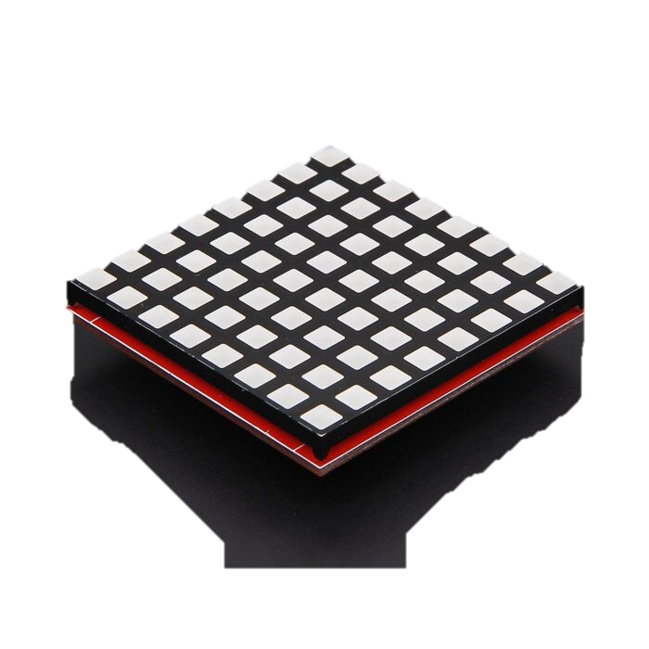
Challenge
Images can be represented as a grid
The grid contains R, G, B values
How many dimensions?
Notes:
Ensure students understand that dimensionality is the properties required to represent a given point, thus since a given point has h, w, (r, g, b) it is 3D (not 2d or 5D)

Slide 10
2D plus 1 more…
each point in the grid is defined by its position and its colour.
the position of any point in the grid is given by its coordinates - h, w
where `h` is the height (row) and `w` is the width (column).
However, the colour of a point is represented by RGB values (r, g, b) describing the red, green, and blue components.
Notes:
Ensure students understand that dimensionality is the properties required to represent a given point, thus since a given point has h, w, (r, g, b) it is 3D (not 2d or 5D)

Slide 11
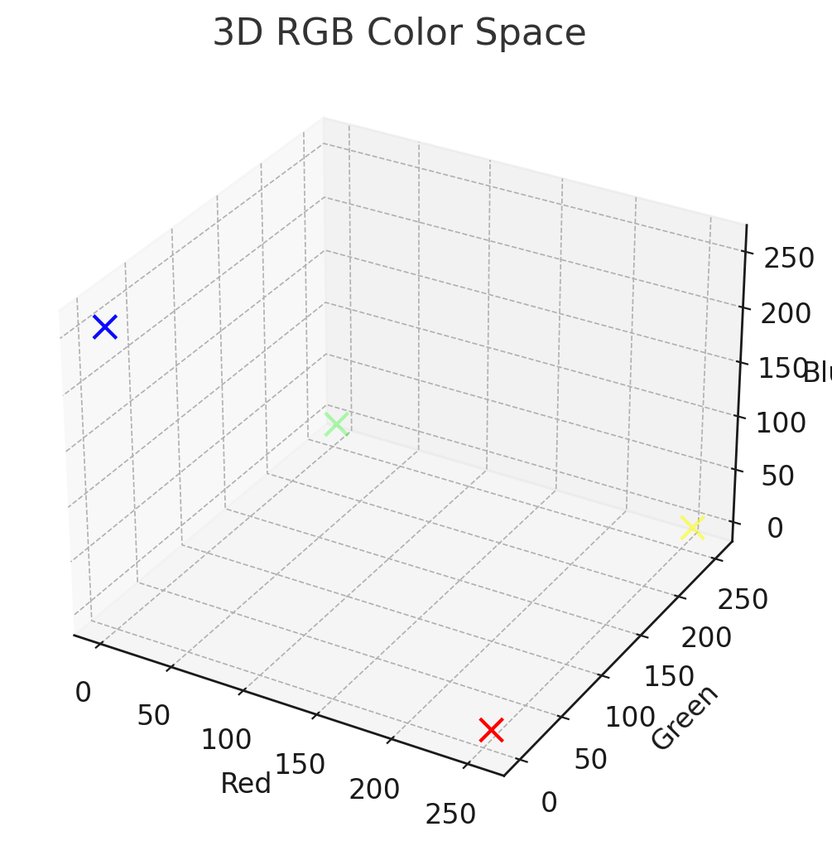
3rd Dimension
These additional properties for each grid point can be considered a 3rd dimension
Notes:
not 2d – this considers only h & w
not 5d – this treats the rgb as being on the same plane as the position, we know the colour properties are separate form the grid properties

Slide 12
Revision
How can you create a 2D list in Python both with and without list comprehension? Provide an example for each.
How would you access the element at row i and column j of a 2D list? Is this sequential or random access?
Explain the difference between sequential and random access when working with 2D lists. When would you use one over the other?

Slide 13
Revision
What are some practical uses of 2D lists in Python? Provide at least two examples where 2D lists could be useful.
What are some potential pitfalls or limitations when working with 2D lists in Python? How might you work around these?
Why might you use libraries like NumPy or Pandas for working with 2D data structures instead of native Python lists? Discuss the benefits they offer and how they build upon Python's native lists and NumPy's arrays.
Notes:
To revise with chatGPT:
https://chat.openai.com/share/a755f5ed-f2e5-42e2-89e9-6f0a0e28745e

Slide 14
Finally:
  Consider the tic-tac-toe game: what data structure does it use? What should it use? How could you use it?

